Slide 1
Chongqing University of Technology
ATAI
Advanced Technique of Artificial Intelligence
Chongqing Unive
Incorporating Circumstances into Narrative Event Prediction
Code： https://github.com/Shichao-Wang/CircEvent.
（EMNLP-2021)
Reported by Zicong Dou

Slide 2
Chongqing University of Technology
ATAI
Advanced Technique of Artificial Intelligence
Chongqing University of Technology
1. Introduction
2. Approach
3. Experiments

Slide 3
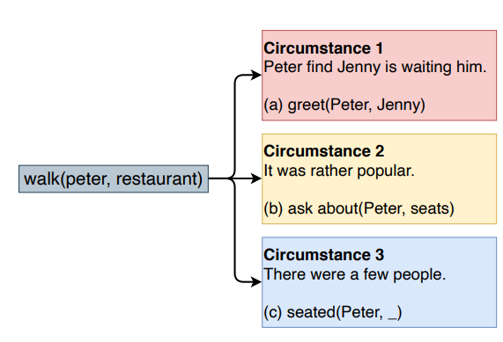
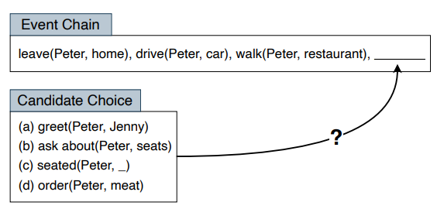
Introduction
We propose the CircEvent, which adopts the multi-head attention to retrieve circumstances at the local and global levels.
And we also introduce a regularization of attention weights to leverage the alignment between events and local circumstances.

Slide 4
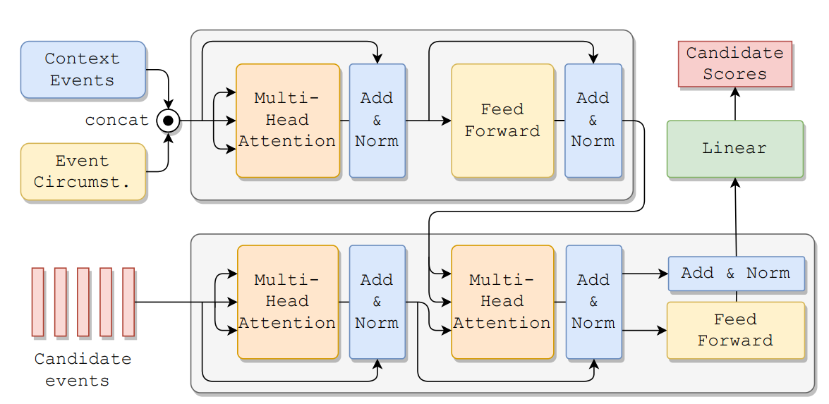
Approach

Slide 5
Approach
Event Representation

Slide 6
Approach

Slide 7
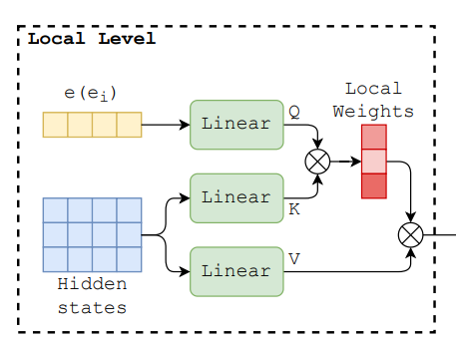
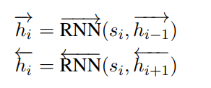
Approach
Event Circumstance Representation
Local：

Slide 8
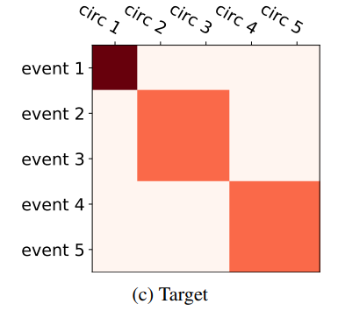
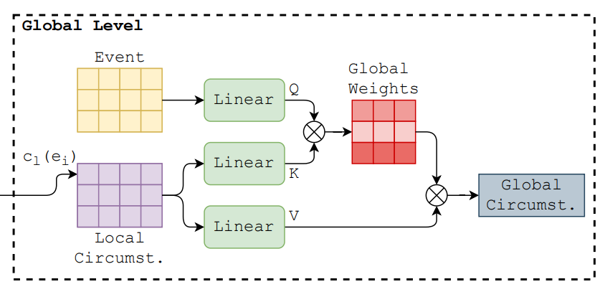
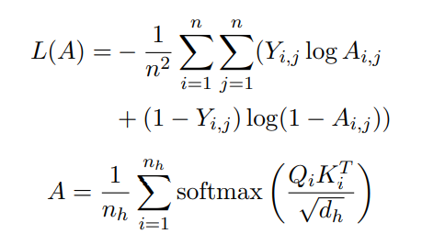
Approach
Event Circumstance Representation
Global + Regularization：
Global：

Slide 9
Approach
Event Chain Encoder

Slide 10
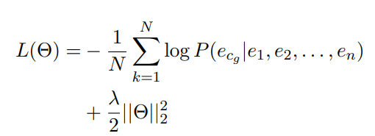
Approach
Training Object
Prediction Layer

Slide 11
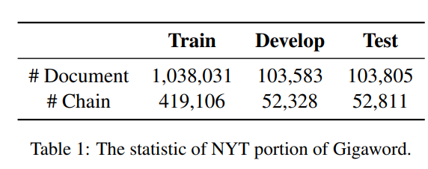
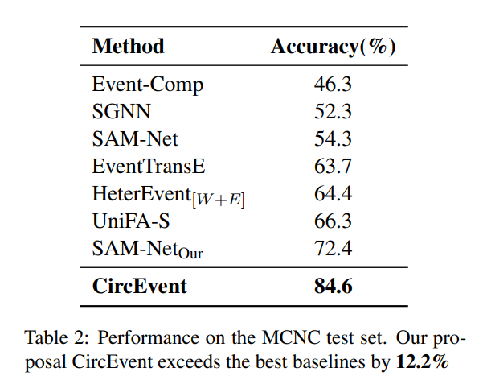
Experiments

Slide 12
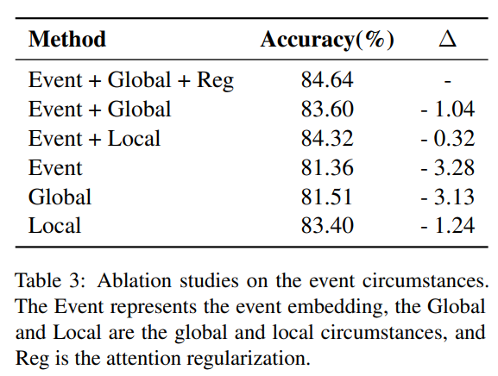
Experiments

Slide 13
Experiments
5月20日，当这些人登上沃德的海胆船时，州渔猎局官员逮捕了他们，船上有468只红鲍鱼。
这些人承认他们捕捞并计划出售鲍鱼。
门多西诺县的一名法官永远禁止两名南加州男子捕鱼，并将他们送进监狱，因为他们携带了加州15年来最大的单次非法鲍鱼运输。

Slide 14
Experiments

Slide 15
Thank you！

